Slide 1
MEDICAL IMAGE SECURITY & ANOMALY DETECTION
By:
S.R. Vidhyambika,
2nd year MTech DS,
Deptartment of IT,
KCT. Roll No: 23MDS011
Guided by:
Dr. N. Rajathi,
Professor,
Department of IT,
KCT

Slide 2
PROBLEM STATEMENT
“Inadequate encryption and access control for medical images jeopardize patient data security and regulatory compliance, especially as digital imaging grows and cyber threats evolve. Existing security measures often fail to protect against modern, complex threats and lack effective anomaly detection, leaving medical images vulnerable to tampering and unauthorized access. This could compromise diagnostic accuracy, violate healthcare regulations, and undermine patient privacy and trust.”
PURPOSE: The motto of this project is to design a more comprehensive security framework that integrates advanced hybrid encryption techniques, secure access control, role-based authentication, and real-time anomaly detection to protect medical images and ensure compliance with privacy regulations.
🔒

Slide 3
COMMENTS FROM REVIEW
From 1st Review:
Blockchain not needed.
Timeline has to be added.
Suggestion to use 2D images first to build primary solution and later integrating the 3D image structures to build final solution in phase 2.
From 2nd Review:
Starting thesis report preparation.
Submitting manuscript in reputed conferences, journals.
From 3rd review
Improve existing proposed system (in next phase)
Implement the solution

Slide 4
ABSTRACT
With the growing reliance on digital healthcare, safeguarding medical images is crucial to protect patient privacy, ensure trust, and prevent data tampering.
This project enhances medical image security using hybrid encryption and hashing algorithms, including RSA+AES+SHA-256, ECC+AES+SHA-256, AES+SHA-256, DNA Cryptography+AES, Blowfish+SHA-256, Chaotic Maps+AES, and DES+AES+MD5.
Medical images in formats like DICOM and JPEG are encrypted, ensuring compliance with HIPAA, GDPR, and India’s Digital Personal Data Protection Act.
These algorithms are evaluated using metrics like PSNR, SSIM, MSE, entropy, edge preservation, and encryption time, achieving SSIM of 1.0, PSNR as infinity, MSE as 0, entropy > 7, and encryption times under 1 ms (per image).
Additionally, deep learning-based anomaly detection analyzes large datasets to identify unauthorized alterations and transmission errors, enabling real-time detection of compromised images.
This approach ensures robust security, preserves image quality, minimizes encryption time, and protects against attacks like brute-force, cryptanalysis, and data breaches.

Slide 5
INTRODUCTION
Medical images, such as X-rays, MRIs, CT scans, etc., are essential for diagnosing and monitoring diseases but contain sensitive patient information, raising concerns about privacy, security, and unauthorized access when sharing across multiple devices.
The growth of digital healthcare and telemedicine has made 2D and 3D medical images increasingly vulnerable to cyber threats.
These threats include ransomware, Distributed Denial-of-Service (DDoS) attacks, data breaches, brute force, and Man-in-the-Middle (MITM) attacks, potentially leading to misdiagnosis, improper care, and privacy issues.
This project addresses medical image security and anomaly detection.
Phase 1 focuses on securing 2D images using hybrid encryption, Multi-Factor Authentication (MFA), and Role-Based Access Controls (RBAC), while Phase 2 uses AI to analyze datasets for detecting unauthorized alterations and transmission errors, enabling real-time identification of compromised images.
The project ensures compliance with strict regulatory standards, including the Health Insurance Portability and Accountability Act (HIPAA) in the United States, the Digital Personal Data Protection Act in India, and the General Data Protection Regulation (GDPR) in the European Union.
By combining multiple encryption algorithms, it aims to provide multi-layered encryption that resists attacks and unauthorized access. MFA and RBAC ensure only authorized users have access, with roles determining accessibility.

Slide 6
OBJECTIVES
This project aims to develop a robust framework ensuring the integrity, confidentiality, authenticity, and reliability of medical imaging data during encryption and decryption, while detecting anomalies in data access and transmission.
Key objectives include:
Confidentiality: Protects patient data from unauthorized access, ensuring privacy and regulatory compliance.
Integrity: Ensures images remain accurate and unaltered, using cryptography and secure protocols for encryption.
Authenticity: Verifies images are genuine through digital signatures and authentication mechanisms.
Reliability: Ensures image availability for clinical decisions with robust storage solutions and backup systems.
Anomaly Detection: Continuously monitors and addresses irregularities, maintaining image security throughout it’s lifecycle.

Slide 7
SCOPE
Overview:
Develop a solution for encryption of medical images, authorized access control and detection of irregularities or anomalies in medical scans.
Deliverables:
End-to-End Encryption (E2EE) using Advanced Encryption Techniques
Accompanied by Deep learning based anomaly detection
Encryption validation
Access control testing
Documentation
Components:
Medical images:
2D:
1. X-ray
2. Mammography
3. Optical Coherence Tomography (OCT)
4. Ultra sound
5. Fluoroscopy
3D: (For Phase II)
1. Computed Tomography (CT) scan
2. Magnetic Resonance Imaging (MRI)
3. Positron Emission Tomography (PET)
Encryption algorithms for security
Deep learning algorithms for anomaly detection (phase 2)

Slide 8
LITERATURE SURVEY
S.No | PAPER TITLE | AUTHOR | DESCRIPTION | PUBLISHER & YEAR
1. | Blind and Robust Watermarking Scheme in Hybrid Domain for Copyright Protection of Medical Images | Ali Alzahrani & Nisar Ahmed Memon | Singular Value Decomposition(SVD), Discrete Wavelet Transform (DWT) and Discrete Cosine Transform (DCT) algorithms were used to watermark images based on spatial and frequency domains. | IEEE - 2021
2. | Chaos Based Secure Medical Image Transmission Model for IoT- Powered Healthcare Systems | Sujarani Rajendran, Manivannan Doraipandian | Used Message-Digest (MD5) algorithm and Lorenz map to generate chaotic series for each medical image. | IOP Science - 2021
3. | DeepKeyGen: A Deep Learning-Based Stream Cipher Generator for Medical Image Encryption and Decryption | Yi Ding, et al. | Uses DeepKeyGen which comprises A generator to generate private key from initial image, a discriminator to distinguish between the private key generated by the generator and the real data from the transformation domain | IEEE - 2021
4. | Lossless image compression-encryption algorithm based on BP neural network and chaotic system | Feifei Yang et al. | Used BP Neural network, Zigzag confusion and Chaotic Pseudo random sequences to compress & encrypt images | Springer - 2020

Slide 9
LITERATURE SURVEY(Contd)
S. No | PAPER TITLE | AUTHORS | DESCRIPTION | PUBLISHER & YEAR
5. | A Novel Plaintext-Related Image Encryption Scheme Based on Chaotic System and Pixel Permutation | Ying Niu, Xuncai Zhang | Uses SHA(384) & Piecewise Linear Color Mapping(PWLCM) to scramble images, chaotic system to generate chaotic sequences for each image and diffuses both to obtain cipher image. | IEEE - 2020
6. | Efficient anomaly detection from medical signals & images with convolutional neural networks for Internet of Medical Things(IoMT) systems | Ali A Khalil et al. | Uses CNN with Convolution with ReLU activation, pooling , dense, softmax layers to detect anomalies. Highest accuracy was observed at 100 epochs | Wiley - 2021
7. | Generative Adversarial Networks for Anomaly Detection in Biomedical Imaging: A Study on Seven Medical Image Datasets | Marzieh Esmaeili et al. | Uses GANs in which generators and discriminators are trained simultaneously to generate fake images and validate it with original image. | IEEE - 2023
8. | Hyperspectral Anomaly Detection With Otsu-Based Isolation Forest | Yuxiang Zhang, et al. | Uses isolation forest by assembling multiple binary trees. To construct more discriminative binary tree, Otsu-based splitting criterion is applied to split subsamples into anomalies and backgrounds. | IEEE - 2021

Slide 10
LITERATURE SURVEY(Contd)
S. No | PAPER TITLE | AUTHORS | DESCRIPTION | PUBLISHER & YEAR
9. | AnoViT: Unsupervised Anomaly Detection and Localization With Vision Transformer-Based Encoder-Decoder | Yunseung Lee; Pilsung Kang | Uses AnoViT comprises encoder using ViT (Multi-head self-attention), a decoder containing a convolutional layer to extract representation that contains normal information in detail, patch embeddings, including relationship between the image patches to construct a three-dimensional feature map and sent to the decoder to preserve the spatial information well. | IEEE - 2022
10. | Anomaly Detection in Medical Imaging with Deep Perceptual Autoencoders | Nina Shvetsova, et al. | Uses autoencoder to understand representation of normal data & pretrained feature with hyper parameter tuning extractor to detect anomalies by calculating anomaly score | IEEE - 2021

Slide 11
EXISTING SYSTEM
Numerous studies on multimedia security focused on safeguarding medical images using techniques like watermarking, steganography, and limited encryption algorithms.
Common approaches included DES, Arnold scrambling, pixel permutation, Self-Adaptive Grey Wolf Optimization, LSB steganography, and transformations like SVD, DWT, DCT, chaotic maps, series, and the Lorenz map.
Steganographic algorithms uses cover images, with methods like LSB, to conceal sensitive medical data, while encryption algorithms, though less frequently researched, typically employed fixed or restricted key sizes for securing information.
Watermarking techniques were applied in spatial, frequency, or hybrid domains, with some studies addressing image distortion by segmenting the image into regions of interest (ROI) and non-interest, embedding watermarks in non-interest regions to preserve image quality.
These methodologies collectively aimed to protect medical images against various threats, including cryptanalysis, JPEG compression, cropping, filtering, brute-force attacks and chosen-plaintext attacks.
Drawbacks:
1. Watermarked images are prone to cropping, rotation, and compression attacks.
2. Limited datasets used in many studies can cause overfitting.
3. Encoding methods may visibly alter images, risking misdiagnosis in critical cases like cancer.
4. Techniques often yield low PSNR, reducing imperceptibility.
5. Poor watermarking distorts images, especially in 3D, affecting spatial consistency.
6. Encryption algorithms like DES are vulnerable to brute-force and cryptanalysis attacks.

Slide 12
METHODOLOGY
Collecting and pre-processing the medical images.
Storing medical images in Digital Imaging and Communications in Medicine (DICOM) format and Joint Photographic Experts Group (JPEG) format.
Encrypting medical images using encryption and hashing algorithms such as:
RSA+AES+SHA-256
ECC+AES+SHA-256
AES+SHA-256
Chaotic Maps + AES
DNA Cryptography + AES
Blowfish+SHA-256
DES+AES+MD5
Implementing all these multi-layer encryption algorithms as a final solution.
Evaluating the algorithms using evaluation metrics such as: Peak Signal-to-Noise Ratio (PSNR), Structural Similarity Index Measure (SSIM), Mean Squared Error (MSE), Edge preservation, Entropy and Encryption time.
This provides a tamper-proof security for sensitive, highly-detailed medical images.
Integrate and test the entire system/solution to ensure seamless functionality, then optimize based on performance and document the methodology and findings for further refinement.
Utilizing any of proposed algorithms in the final solution based on the use case for secure transmission of data.

Slide 13
Work Flow Diagram Of Hybrid End-to-end Encryption
2D Medical Image Dataset
Hybrid Encryption
Transmission over network
Decryption
Evaluation of obtained image
Preprocessing

Slide 14
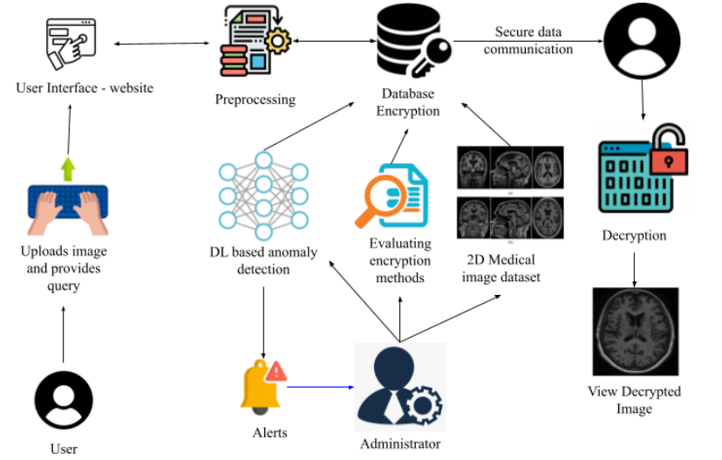
Work Flow Diagram Of Hybrid End-to-end Encryption

Slide 15
PROJECT TIMELINE USING GANTT CHART
TASK ID | TASK NAME | START DATE | END DATE | DURATION in days | WEEKS : Completed In-Progress Not Yet Started
 |  |  |  |  | 1 | 2 | 3 | 4 | 5 | 6 | 7 | 8 | 9 | 10
1 | Problem study, objective framing, scope definition, planning | 20/08/24 | 23/08 | 4
2 | Literature Review | 24/08 | 06/09 | 14
3 | Data Collection, Pre-processing, TNSTC Funding Proposal submission | 07/09 | 13/09 | 7
4 | Data Encryption & Security Implementation of proposed algorithms | 14/09 | 30/09 | 17
5 | Preparation of manuscript, Submission, Modification | 15/09 | 05/10 | 21
6 | YUKTI PoC submission | 28/09 | 28/09 | 1
7 | Evaluation of performance, speed, strength of security, accuracy of the algorithms | 30/09 | 04/10 | 5
8 | Coursera project courses | 06/10 | 30/10 | 25
9 | Documentation & Reporting | 19/10 | 30/10 | 8

Slide 16
TECHNOLOGY STACK
The required technology stack for implementation is
Software specification:
Google Colab/Jupiter Notebook / Colab Pro
Hardware Specifications:
Processor: Intel core i7 / i9 / ultra 7 / ryzen 7
RAM: 8 GB
OS: Windows 11
SSD: 256 GB
External: Keyboard, Mouse
Dataset source : Kaggle, Cancer Imaging Archive

Slide 17
MODULES
ADMIN MODULE
1.1 User Management
Manage user accounts, roles, and permissions.
1.2 Data Management
Oversee the management of medical image datasets, including uploading, organizing, and maintaining data integrity.
1.3 Encryption Settings
Configure encryption algorithms and settings for securing medical images.
2. USER MODULE
2.1 User Authentication
Implement secure login and access control mechanisms for users.
2.2 Image Upload and Encryption
Allow users to upload medical images for encryption using selected algorithms.
2.3 View Encrypted Images
Enable users to access and view encrypted medical images and their corresponding cryptographic hashes for integrity verification.

Slide 18
MODULES (Contd)
3. IMAGE ENCRYPTION MODULE
3.1 Algorithm Implementation
Implement various encryption algorithms for medical images:
RSA+AES+SHA-256
ECC+AES+SHA-256
AES+SHA-256
Chaotic Maps + AES
DNA Cryptography + AES
Blowfish+SHA-256
DES+AES+MD5
Rivest-Shamir-Adleman (RSA)
Elliptic Curve Cryptography (ECC)
Homomorphic encryption (if applicable)
3.2 Format Support
Support encryption for various medical image formats (DICOM, JPEG).
3.3 Performance Evaluation
Evaluate encryption performance metrics such as PSNR, SSIM, MSE, Edge preservation, Entropy and Encryption time.

Slide 19
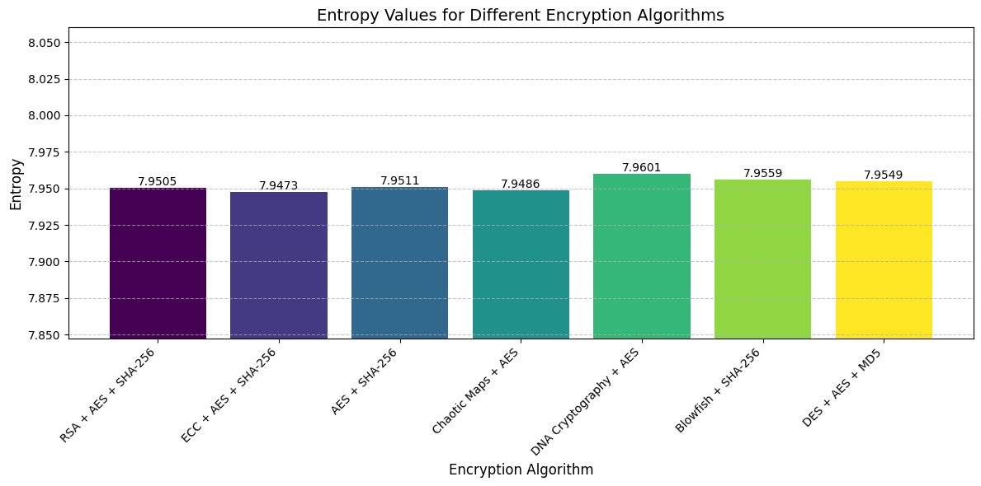
RESULTS
Similarity Index Measure (SSIM) score for the decrypted images for all the algorithms is 1.
Mean Squared Error (MSE) score for the decrypted images for all algorithms is 0.0.
Edge Preservation score for the decrypted images for all algorithms is 1.0.
Peak Signal-to-Noise Ratio (PSNR) score for the decrypted images for all algorithms is infinity.
Entropy score observed for decrypted images for all algorithms is shown in the graph below:

Slide 20
RESULTS (Contd)
Encryption time observed for each decrypted image for all algorithms is shown in the table below:
Hybrid Encryption Algorithms | Encryption time for each medical image
1. RSA + AES + SHA-256 | 0.05696s
2. ECC + AES + SHA-256 | 0.00012s
3. AES + SHA-256 | 0.00004s
4. Chaotic Maps + AES | 0.00003s
5. DNA Cryptography + AES | 0.00004s
6. Blowfish + SHA-256 | 0.00008s
7. DES + AES + MD5 | 0.00010s

Slide 21
ACHIEVEMENTS
Project proposal was submitted for funding to Tamil Nadu State Council for Science and Technology (TNSTC) on 9th September.
Proof of Concept (PoC) was submitted to YUKTI National Innovation Repository on 28th September.
Manuscript titled “Comparison of Hybrid Encryption Algorithms for Medical Image Security” was submitted to International IEEE Conference on Advancements in Biomedical Systems and Healthcare Technology at PSG College of Technology, Coimbatore on 5th October.

Slide 22
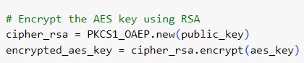
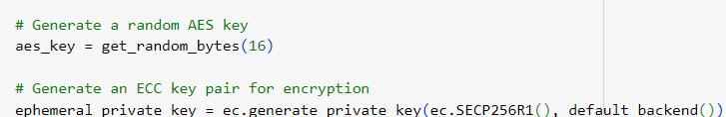
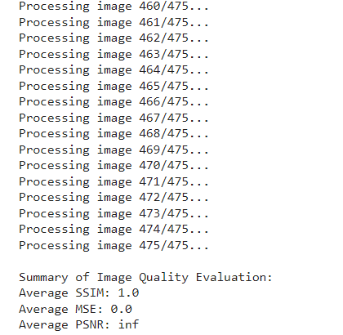
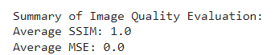
SCREENSHOTS

Slide 23
BENEFITS
Protecting patient privacy
Data Integrity
Secure Data Sharing
Maintaining Reputation
Mitigation of Legal Risks
Support for Radiologists
Support for Remote Diagnostics
Improved Accuracy
Reduced Diagnostic Errors
Reduced Healthcare Costs
Prevention of Identity Theft
🔒

Slide 24
REFERENCES
A. Alzahrani and N. A. Memon, “Blind and robust watermarking scheme in hybrid domain for copyright protection of medical images,” IEEE Access, vol. 9, pp. 113714–113734, Jan. 2021, doi: 10.1109/access.2021.3104985.
S. Rajendran and M. Doraipandian, “Chaos based secure medical image transmission model for IoT- powered healthcare systems,” IOP Conference Series Materials Science and Engineering, vol. 1022, no. 1, p. 012106, Jan. 2021, doi: 10.1088/1757-899x/1022/1/012106.
Y. Ding, F. Tan, Z. Qin, M. Cao, K.-K. R. Choo, and Z. Qin, “DeepKeyGen: a deep Learning-Based stream cipher generator for medical image encryption and decryption,” IEEE Transactions on Neural Networks and Learning Systems, vol. 33, no. 9, pp. 4915–4929, Sep. 2022, doi: 10.1109/tnnls.2021.3062754.
F. Yang, J. Mou, K. Sun, and R. Chu, “Lossless image compression-encryption algorithm based on BP neural network and chaotic system,” Multimedia Tools and Applications, vol. 79, no. 27–28, pp. 19963–19992, Apr. 2020, doi: 10.1007/s11042-020-08821-w.
“A novel Plaintext-Related image encryption scheme based on chaotic system and pixel permutation,” IEEE Journals & Magazine | IEEE Xplore, 2020. https://ieeexplore.ieee.org/document/8972445
A. A. Khalil et al., “Efficient anomaly detection from medical signals and images with convolutional neural networks for Internet of medical things (IoMT) systems,” International Journal for Numerical Methods in Biomedical Engineering, vol. 38, no. 1, Dec. 2021, doi: 10.1002/cnm.3530.
“Generative Adversarial networks for Anomaly Detection in Biomedical Imaging: A study on seven medical image datasets,” IEEE Journals & Magazine | IEEE Xplore, 2023. https://ieeexplore.ieee.org/document/10043696/authors#authors

Slide 25
REFERENCES (Contd)
8. “Hyperspectral anomaly detection with OTSU-Based Isolation Forest,” IEEE Journals & Magazine | IEEE Xplore, 2021. https://ieeexplore.ieee.org/document/9531356
9. “ANOVIT: Unsupervised Anomaly Detection and Localization with Vision Transformer-Based Encoder-Decoder,” IEEE Journals & Magazine | IEEE Xplore, 2022. https://ieeexplore.ieee.org/document/9765986
10. “Anomaly detection in medical imaging with deep perceptual autoencoders,” IEEE Journals & Magazine | IEEE Xplore, 2021. https://ieeexplore.ieee.org/document/9521238

Slide 26
CLARIFICATIONS, IF ANY

Slide 27
THANK YOU

